Slide 1
CTE 2059 - Computer Graphic Lecture 3 – Camera & Animations
University of Engineering and Technology
VIETNAM NATIONAL UNIVERSITY, HANOI

Slide 2
Outline
Getting Started
Installation
How to use the studio?
Camera & Orbit Controls
Perspective Camera
Multi-View Technique
Orbit Controls
Animations
Hierarchy
Keyframes
Interpolation
Hands-On Activity

Slide 3
Getting Started

Slide 4
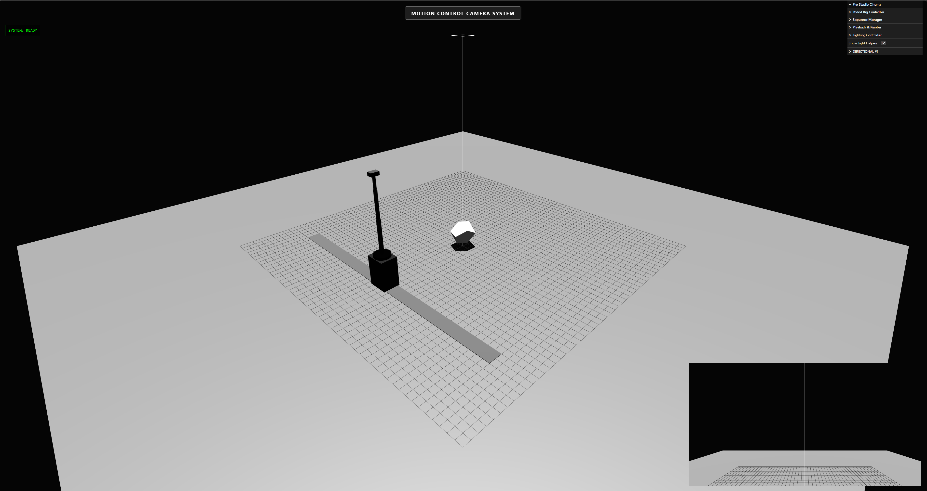
Installation
Open VSCode and create a new folder
Download the source code for Lecture 3 from the UET Portal
Run the source code. You should see a webpage that mimics a filming studio:

Slide 5
How to use the studio?
In this lesson, you will take on the role of a visual director on a film set.
Your film set includes:
An object at the center
A motion control camera system (i.e., a camera mounted on a robot arm)
A lighting system (similar to the lighting system in Lecture 2)
Motion Control Camera System with 2 helper modules:
Robot Rig Controller: manually adjusts the robot’s motion
Sequence Manager: automatically adjust the robot based on a predefined set of motions
You can add/delete/export/import/record any sequence of animations.

Slide 6
Camera & Orbit Controls

Slide 7
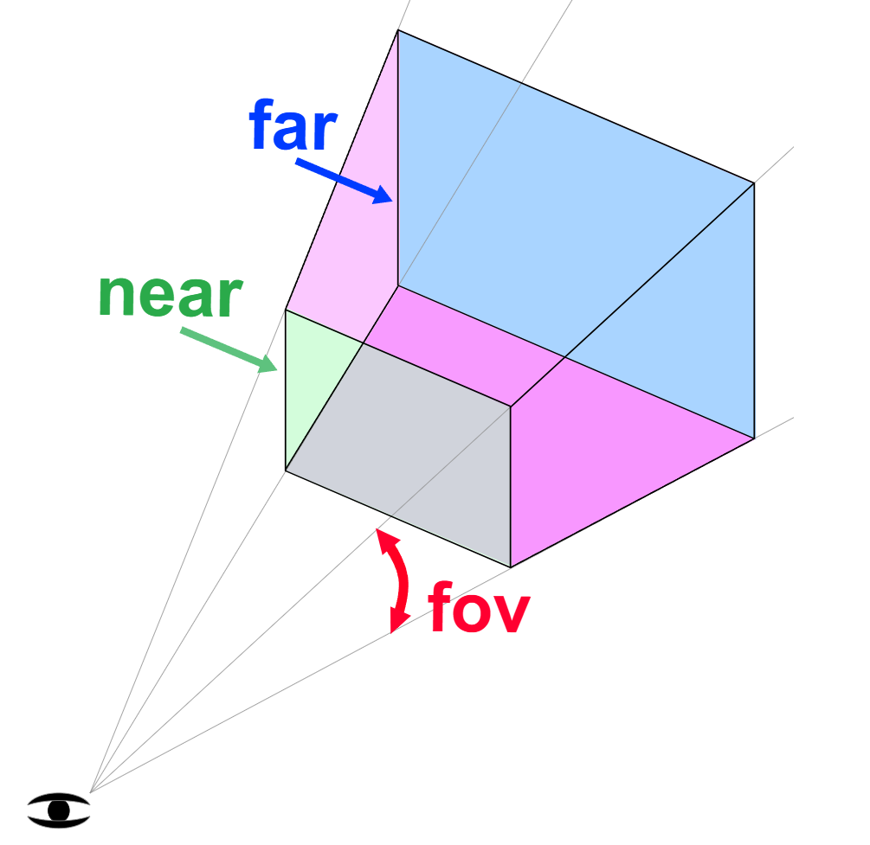
Perspective Camera
The most common camera in three.js and the one we’ve been using so far.
A perspective camera simulates a real lens through the concept of a frustum:
FOV (Field of View): The vertical angle of the pyramid.
Smaller FOV = Larger Focal Length = Zoom In
Aspect Ratio: Set to match the canvas width/height to prevent stretching.
Near / Far Plane: The minimum and maximum distance. Prevents rendering unnecessary objects => More performance.
Notes:
Frustum: Hình chóp cụt

Slide 8
Multi-View Technique (Picture-in-Picture)
Viewport:
Viewport is a rectangular area on the canvas where WebGL projects and renders the camera’s view.
Coordinate system: Measured from the bottom-left of the canvas.
x, y are the start coordinates; w, h are width and height
When to use? When you want to render multiple camera windows on the same canvas (e.g., split-screen, mini-map, pic-in-pic).
Scissor Test:
The scissor test is a pixel clipping mechanism, it only allows color writes for pixels inside the scissor rectangle, pixels outside are ignored.
When to use? Use scissor to protect regions from being overwritten (e.g., UI overlays) or to optimize rendering when drawing multiple views on a single canvas.
Notes:
Scissor Test is different from the viewport because scissor prevents writing outside the region rather than changing the projection.

Slide 9
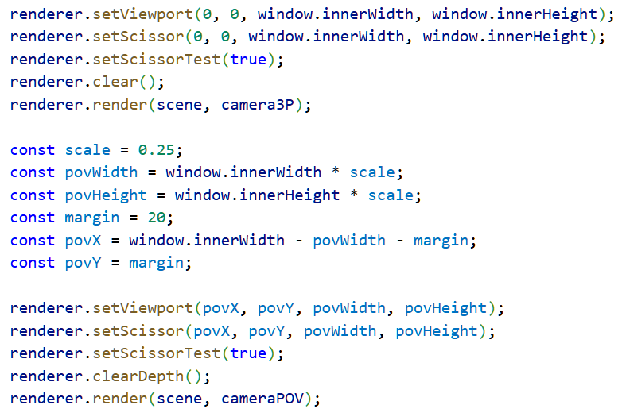
Multi-View Technique (Picture-in-Picture)
Viewport and Scissor are used inside the animate function (render loop) because the are part of the per-frame rendering state in WebGL.
In this example:
The camera3P scene is drawn normally.
The depth buffer is then cleared, so objects in cameraPOV are not hidden behind objects from camera3P.
The color buffer remains, so the overlay appears on top of the first render.
This is a common technique in three.js for HUDs, selection boxes, or multi-scene rendering.
Notes:
Rendering state resets each frame
- WebGL doesn’t “remember” viewport or scissor settings across different render calls in a complex scene.
- If you render multiple cameras or multiple regions on the same canvas, you must re‑apply the correct viewport and scissor before each renderer.render(scene, camera) call.
2. Multiple views on one canvas
- In split‑screen or dashboard layouts, each camera has its own viewport/scissor rectangle.
- During the animation loop, you switch between cameras, so you need to set the viewport and scissor for each one before rendering.
3. Dynamic layouts
- If the canvas size changes (e.g., window resize, responsive UI), the viewport/scissor coordinates must be recalculated every frame to match the new dimensions.
- Putting them in the animate loop ensures they stay in sync with the canvas size and devicePixelRatio.
4. Consistency and correctness
- Forgetting to set viewport/scissor in the loop can cause later renders to overwrite the wrong region or bleed into other areas.
By explicitly setting them each frame, you guarantee that every render call respects the intended boundaries.
renderer.clear() clears all active buffers (color, depth, and stencil), while renderer.clearDepth() only clears the depth buffer.
This distinction is crucial when layering multiple scenes or overlays: you often want to preserve the color buffer but reset depth information so new objects can render on top.
Why this matters:
renderer.clear() is like wiping the canvas entirely. It’s usually called once per frame if autoClear is disabled.
renderer.clearDepth() is more surgical: it resets depth testing without erasing the color buffer. This is useful when you want to render a second scene (like UI elements, selection boxes, or overlays) on top of the first scene without being occluded by depth values from the first render
Key takeaway
Use renderer.clear() when you need a fresh frame.
Use renderer.clearDepth() when layering scenes or overlays, ensuring new objects render on top without erasing the existing image.

Slide 10
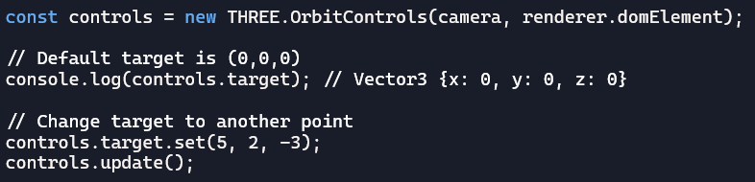
Orbit Controls
Unlike moving the camera directly, Orbit Controls moves the camera on a Spherical Path around a specific point like a Satellite.
Orbit Controls keeps the camera’s “up” direction aligned with the positive Y-axis by default.
The target property determines where the camera is looking – defaulted to (0,0,0).
Possible User Inputs:
Left Click: Changes Azimuth (horizontal) and Polar (vertical) angles.
Right Click: Shifts the target (Panning).
Scroll: Changes the distance (Radius) from the target.
Notes:
If you want the camera to orbit around another object instead of the origin, set the target to that object’s coordinates
Spherical Coordinates:
Azimuth: Horizontal Angle (left / right)
Polar: Vertical Angle (Up / Down)
Distance: Radius of the orbit.

Slide 11
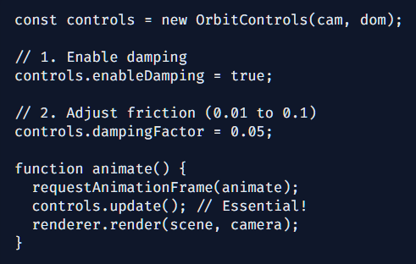
Interaction Damping: Adding Weight
Damping creates Inertia.
When you stop moving the mouse, the camera slowly glides to a halt instead of stopping instantly.
Why use it?
It makes the interface feel more natural, mimicking physical motion camera in action.
Requirement
You MUST call controls.update() in the animation loop for damping to calculate frame-by-frame friction.
Notes:
If you want the camera to orbit around another object instead of the origin, set the target to that object’s coordinates

Slide 12
Animations

Slide 13
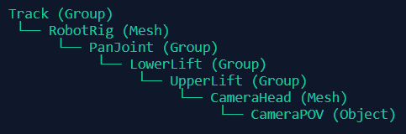
Scene Graph Hierarchy
Our Robot uses a Parent-Child Chain. Transformations flow “downward”.
Hierarchy logic:
Parent: Pan Joint
Child: Lower Lift
If Pan Joint rotates, the Lower Lift circles around the joint while maintaining its own rotation.
Local Space vs. World Space
The cameraPOV doesn't need to know where the robot is; it only cares about its position on the head!
Local Space: coordinates relative to the direct parent.
World Space: coordinates relative to (0,0,0) of the Scene.
Three.js objects have matrixWorld property:
M_world = M_parent_world * M_child_local
Notes:
Every time you move a joint, Three.js recomputes these 4x4 matrices for every child in the tree. This is why nested groups are so powerful for Robot Rigs

Slide 14
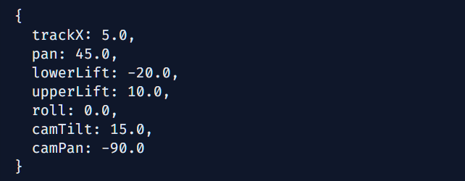
Keyframes
A Keyframe is a snapshot of all mutable states of the robot rig at a specific “checkpoint”
The goal of animation is to transition between keyframe i and i+1 over time.
The Smoothness Trade-off
How much data do we need for a 10-second animation?
Stepped (Manual): Requires 60 keyframes per second. Huge file size, impossible to edit.
Interpolated (Procedural): Only needs 2 keyframes (Start/End). Math fills the missing frames automatically.
Notes:
Interpolation converts "Data" into "Experience".
Interpolation dựa trên bài toán khớp đường cong (curve fitting) và spline interpolation.

Slide 15
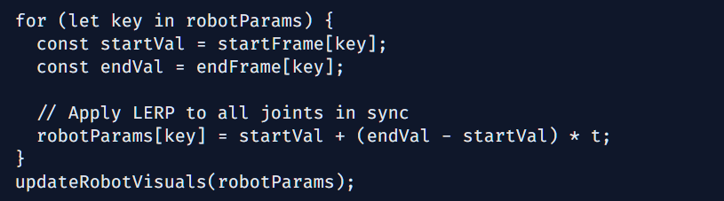
Linear Interpolation – LERP
LERP is a commonly used technique in computer graphic to smooth out the transition between keyframes. It is the core of procedural animation.
Value = A + (B – A) * t
A: Starting value (Keyframe 1)
B: Ending value (Keyframe 2)
T: Progress normalized from 0.0 to 1.0 (speed of transition)
Multi-Parameter Synchronization
The robot doesn’t just pan; it moves all joints simultaneously using a single t value.
Notes:
Interpolation converts "Data" into "Experience".
Interpolation dựa trên bài toán khớp đường cong (curve fitting) và spline interpolation.

Slide 16
Hands-On Activity Pre-programmed sequence for Motion Control Camera System

Slide 17

Hands-On Activity
Activity: How to draw a cat?
In this activity, you are provided with a sample picture of an orange cat.
Your tasks are:
Identify the structural characteristics of the cat (i.e., which shapes form the cat’s structure).
Implementing these shapes in Three.js
Create a function to group all these shapes and return a single object that represents the cat.

